Slide 1
Images of HDF5
Gerd Heber
The HDF Group
The 15th HDF and HDF-EOS Workshop
April 17-19, 2012

Slide 2
Outline
Five long stories distilled into shorts:
A model of the information in an HDF5 file
A new XML representation of HDF5
HDF5 as a Service
The HDF5 user experience I always wanted
An odd couple – HDF5 and databases

Slide 3
HDF5 Information SET
“Language shapes the way we think, and determines what we can think about.”
(Benjamin L. Whorf)

Slide 4
HDF5 Information Set
Is a model of the content of an HDF5 file
Provides a consistent set of definitions
Gives an undistorted view of HDF5*
Puts the simplicity of HDF5 center stage
*Not tainted by the idiosyncrasies of a particular API

Slide 5
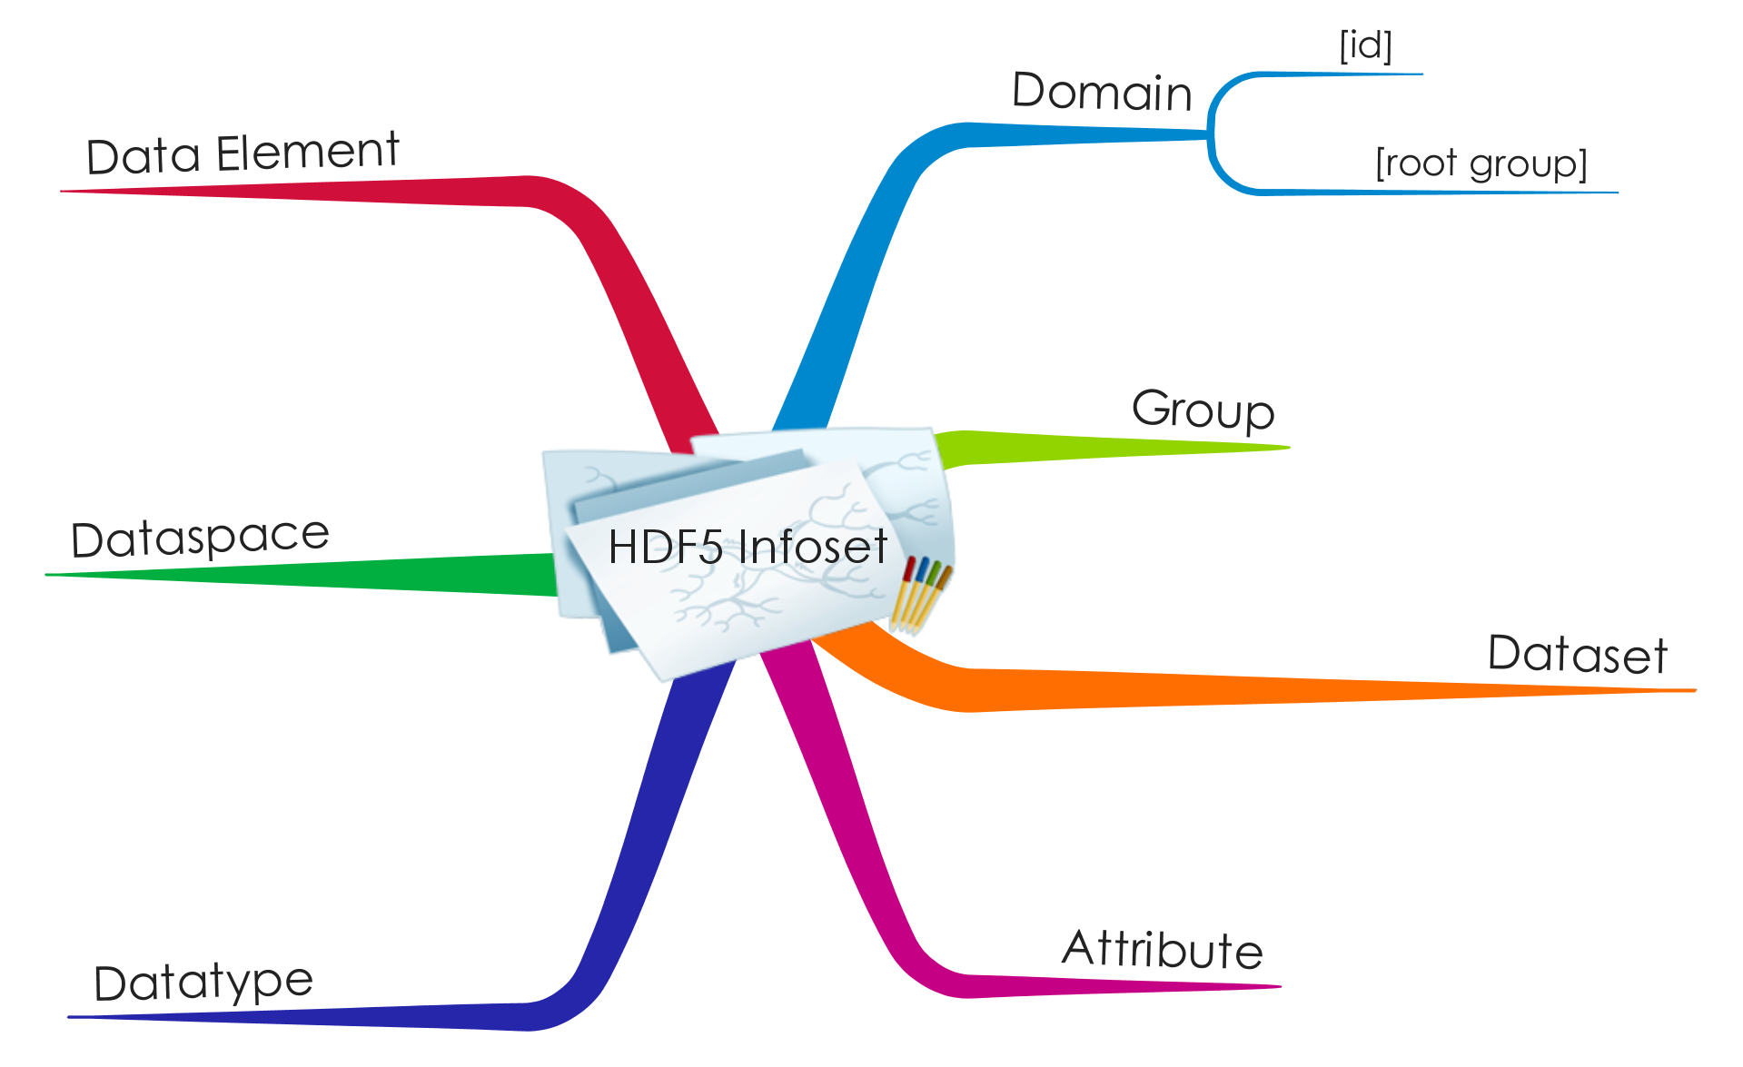
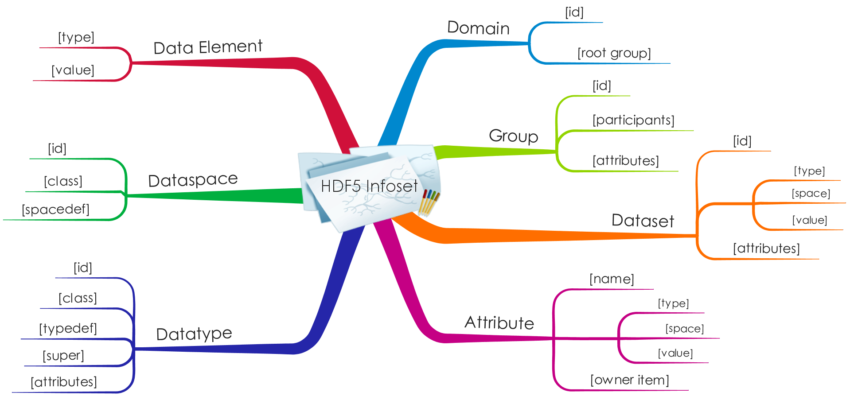
HDF5 Information Set

Slide 6
Sources of Complexity
Productivity
  Finite number of parts and combining-rules yields an infinite number of unique structures
  HDF5 groups and datatypes
Reference (Cohesion)
  The ability to refer from one part to another
  HDF5 groups, links, and references
(By comparison, databases are only weakly productive and their referential capabilities are limited by Codd’s Information Principle.)

Slide 7


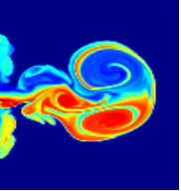


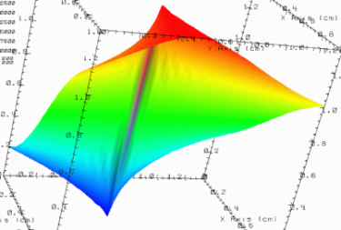
HDF5 Micro-Web
Every HDF5 file
has a root group
/
Experiment Notes:
Serial Number: 99378920
Date: 3/13/09
Configuration: Standard 3
Viz
SimOut
Parameters
10;100;1000
IMG1
TBL1
TBL3
Ext
lat | lon | temp
----|-----|-----
12 | 23 | 3.1
15 | 24 | 4.2
17 | 21 | 3.6
IMG2
IMG3
TBL2
TBL1
Timestep
36,000
September 28-30, 2010
HDF/HDF-EOS Workshop XIV
7

Slide 8
Hypermedia
Hypermedia – An application that uses
associative relationships among information
contained within multiple media data
for the purpose of facilitating access to and
manipulation of the information encapsulated by
the data.
[Lowe & Hall 99]

Slide 9
Questions?

Slide 10
Representing HDF5 IN XML
“We find that the same word – Fidelity – can be used both in connection with the excellence of sound reproduction and picture reproduction.”
(1931 Electronics Oct. 137/1)

Slide 11
Use Cases
Viewing structure and contents of an HDF5 file in a web browser (XSLT in the browser)
XML as a catalog record
XML as a light-weight intermediate form for applications
Generation, validation, and reconstruction of HDF5 files
XML as intermediate to other data languages or file formats (e.g., ISO, netCDF)
XML as machine-readable documentation
Templates, skeleton files, etc.
(Source: The XML DTD for HDF5: Design Notes. 12 June 2000)
10+ years on – still a pretty complete list! Where are we?

Slide 12
HDF5/XML Survey
http://www.surveymonkey.com/s/RMSZSSX
13 replies to date (still open)
Users are fluent in XML Schema, XPath, XSLT, and XLink/XPointer
Descriptive data are more important than a full-fledged data element representation
Hardly anybody uses the HDF Group’s XML schema, most respondents created their own
Split on the fidelity of the representation

Slide 13
Why another schema?
Address shortcomings
  Omissions
  Eliminate redundancies
  De-normalized group structure representation
  Dataset and attribute value serialization
  Simplify tools
Reflect simplicity of the HDF5 data model
High-fidelity representation
Be neutral with respect to application domains
Future proofing

Slide 14
High-Level Structure
<domain xmlns=“http://www.hdfgroup.org/HDF5/XML/schema/2011/11/11”
xmlns:xlink=“http://www.w3.org/1999/xlink”>
<!-- “Pointer” to the HDF5 root group -->
<root xlink:href=“903d1d75-e617-4767-a3bf-0cb3ee509027”/>
<linkbase>
<!–- Representations of HDF5 groups -->
</linkbase>
<database>
<!–- Representations of HDF5 datasets -->
</database>
<encodingbase>
<!-- Collection of representations of HDF5 datatypes -->
</encodingbase>
</domain>

Slide 15
HDF5/XML Summary
HDF5/XML is a high-fidelity rendering of user-level HDF5 items in XML
Communities/domain experts should create XML representations that work for their users
  HDF5/XML cannot fill that role
One can use XSLT or XQuery to connect to the HDF5/XML tool chain (to be developed)
See me for a demo and additional information / questions /comments / suggestions / donations

Slide 16
Questions?

Slide 17
HDF5/REST*
But let your communication bee, GET, PUT: POST, DELETE: For whatsoeuer is more then these, commeth of euill.”
(Matthew 5:37, KJV 1611, Tyndale 1526)
*The support of Wenming Ye and Daniel Odievich (Microsoft) for this project is gratefully acknowledged.

Slide 18
Outline
REST
  Resources
  Representations
  URIs
Cloud / Windows Azure
Summary

Slide 19
REST*
*REpresentational State Transfer
[Fielding 2000]
the Internet as it was originally conceived
is perfectly suited for transferring both hypermedia-based documents and data
[Scribner & Seely 2009]
Why create complex data service architectures when
?

Slide 20
Four Simple Principles
The server maintains resources that are separate from representations returned to clients
Clients manipulate resources via the representations issued to them
The messages that convey representations to the client are self-describing
Application state is transferred using hypermedia techniques
[Scribner & Seely 2009]

Slide 21
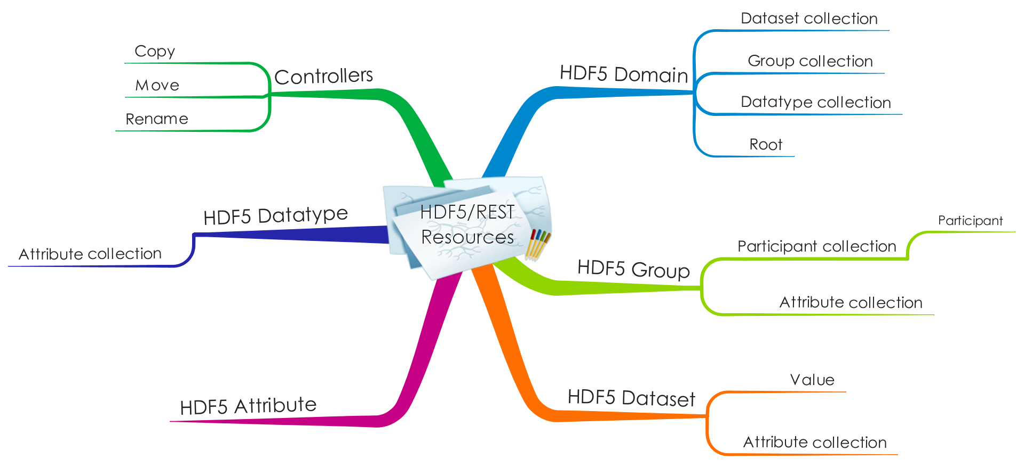
HDF5/REST Resources

Slide 22
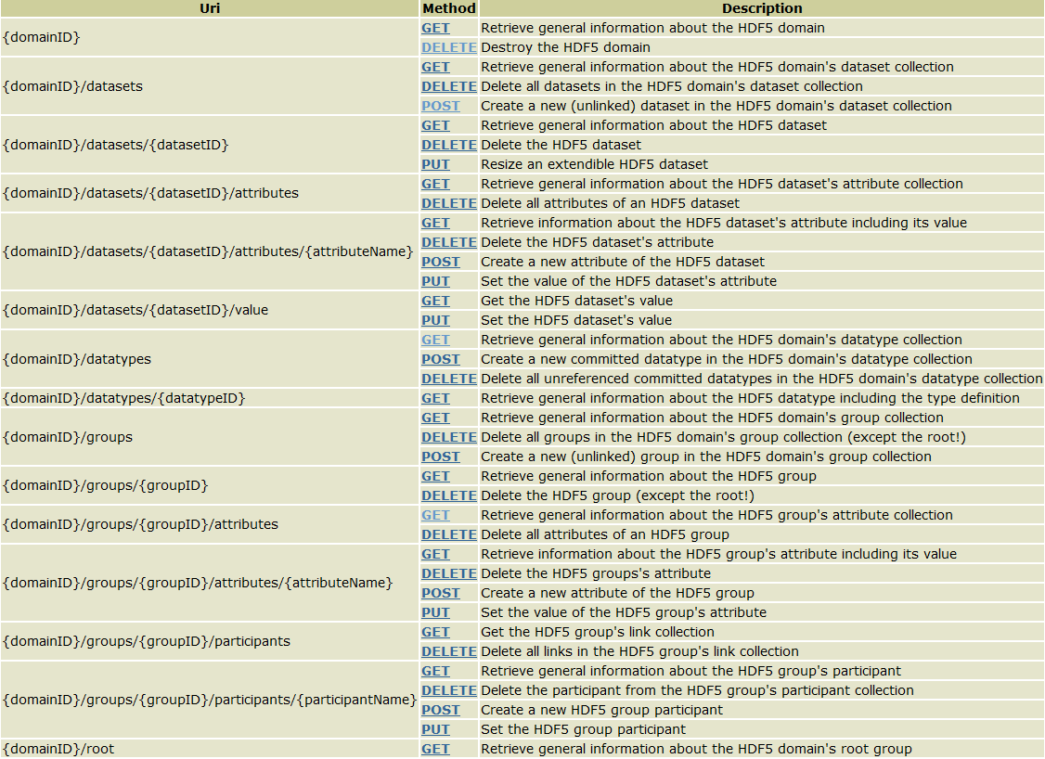
HDF5/REST URIs

Slide 23
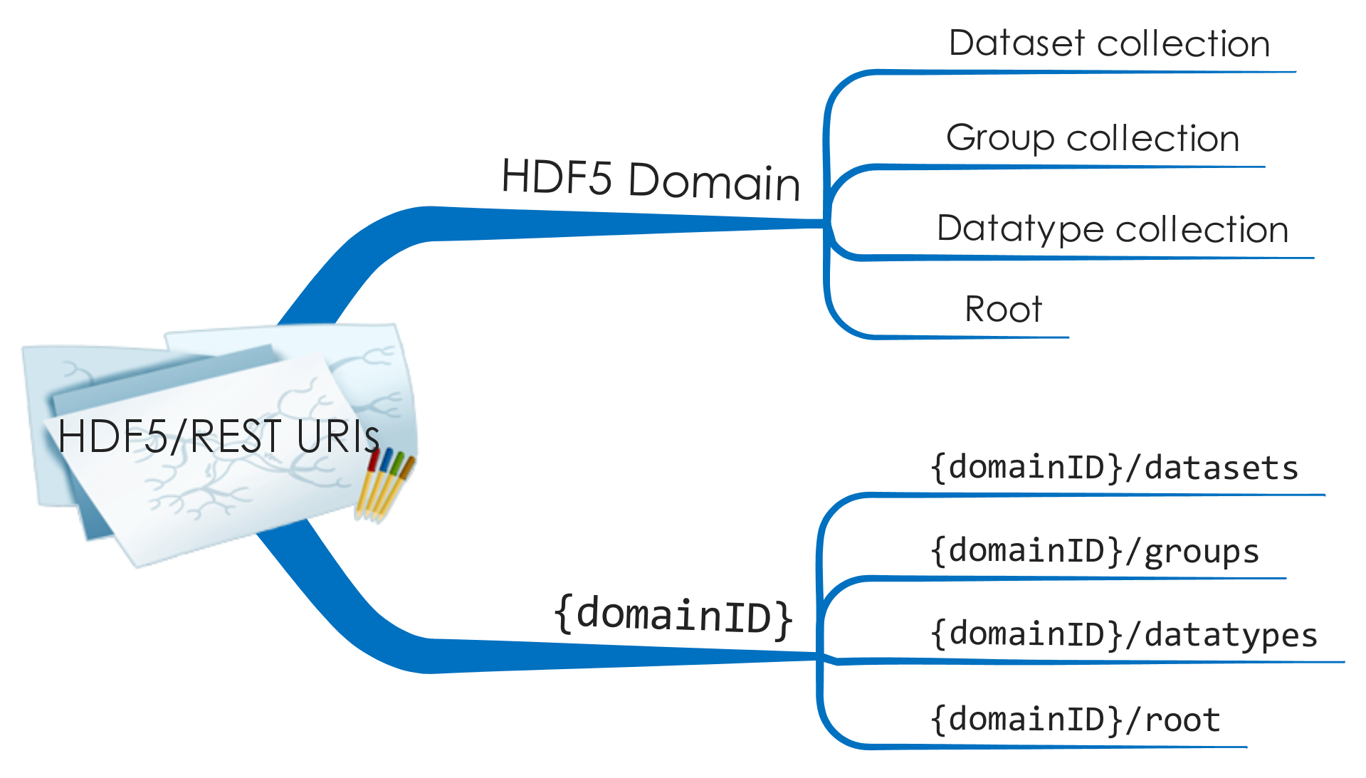
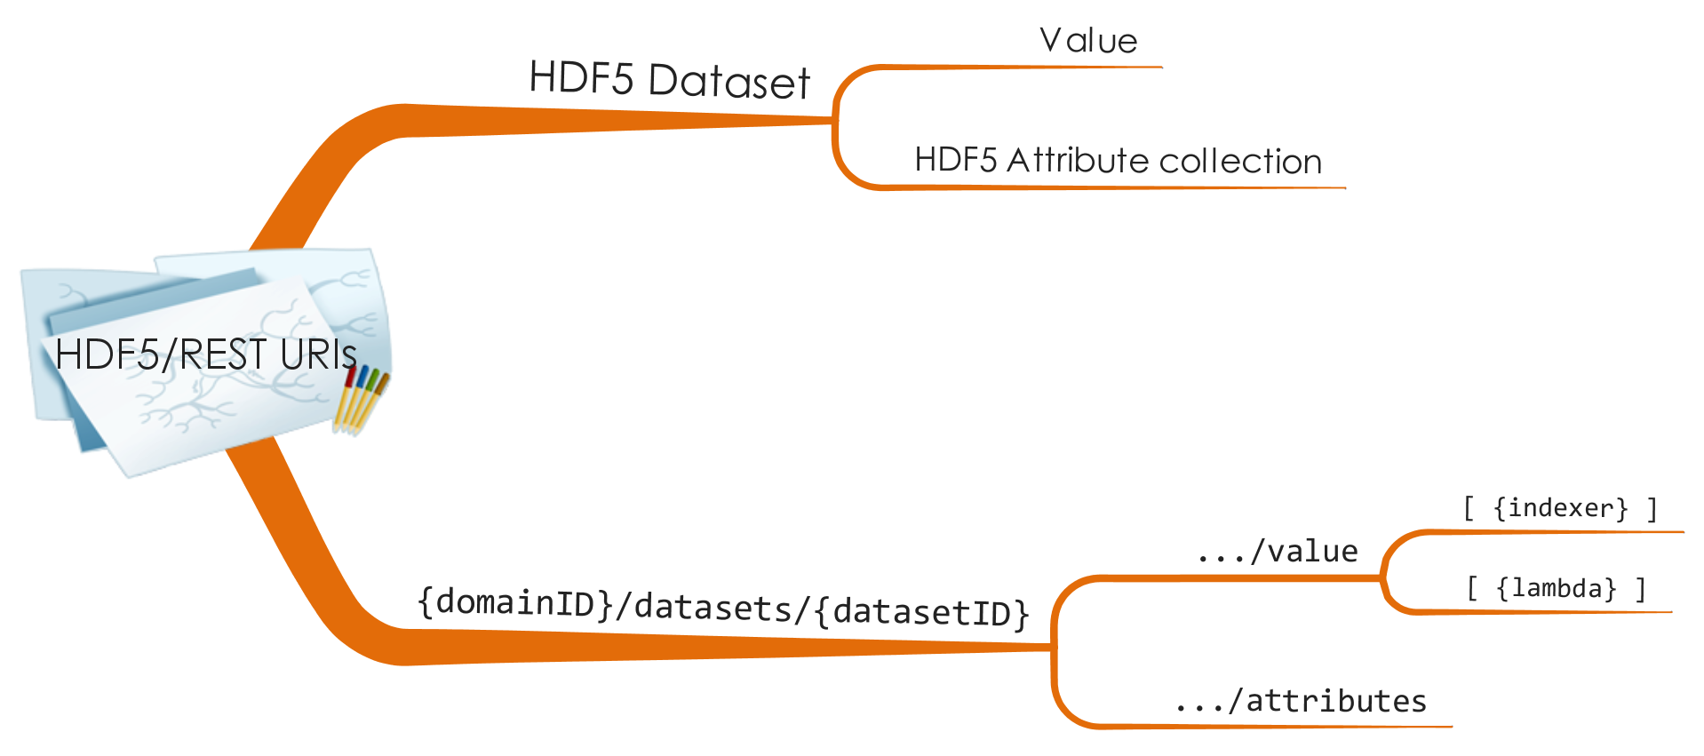
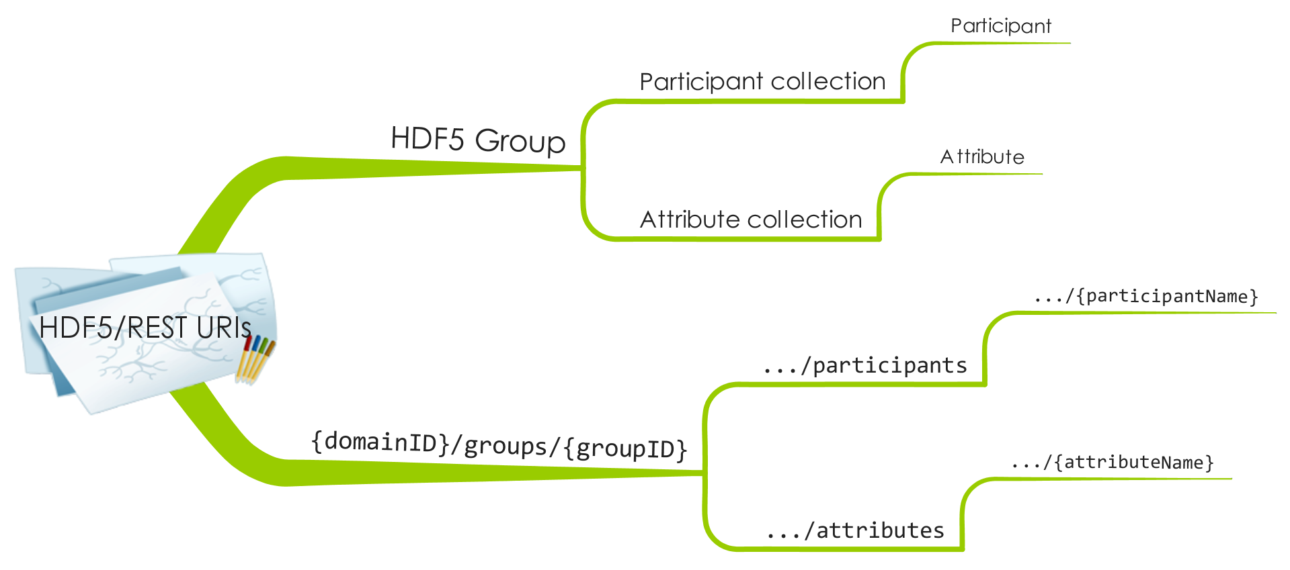
HDF5/REST URIs – Examples

Slide 24
Examples
Get (a representation of) the HDF5 root
Create a new HDF5 group (unlinked)
Link the newly created group as ‘New Group’
Delete an HDF5 attribute
GET /root
POST /groups # server replies with {groupID}
POST /groups/{groupID1}/participants/New%20Group
{groupID} # content
DELETE /datasets/{datasetID}/attributes/{name}

Slide 25
Representations
Clients express preferences via Accept header
Server may reply with
or
Accept: application/json;0.9,
text/xml, application/xml;q=0.8,
application/octet-stream;q=0.7,
image/png, image/gif, image/jpeg;q=0.2,
*/*; q=0.1
Accept-Encoding: gzip, deflate, compress;q=0.9
Content-Type: text/xml
Content-Length: 2890
…
HTTP/1.1 406 Not Acceptable

Slide 26

Windows Azure
SDK
VS
Fabric
Storage
Watch Steve Marx’s
“What is Windows Azure?”

Slide 27
Windows Azure Implementation
Why it’s easy…
HDF5/XML proxy
XSLT does most of the heavy lifting
HDF5DotNet for data access
Great development and deployment tools
Easy scale-out
Challenges
Cloud BLOB/block stores aren’t file systems
Performance from
  Caching
  Latency hiding
  Parallelism

Slide 28
HDF5/REST Summary
HDF5/REST is an “HTTP API” for HDF5
RISC rather than CISC
Build more complex services on top of HDF5/REST (e.g., HDF5DNS, HDF5WHOIS)
HDF5 domains = “virtual HDF5 files”
See me for a demo and additional information / questions /comments / suggestions / donations

Slide 29
Questions?

Slide 30

An HDF5 Module for
A Winning Team:
HDF5 + The Best Shell on the Planet
Notes:
Introduce Windows PowerShell, scripting or shell languages, What is a provider?

Slide 31

A Word from the Author
“In the end, there’s no hard-and-fast distinction between a shell language and a scripting language. Some of the features that make a good scripting language result in poor shell user experience.
Because PowerShell’s goal is to be both a good scripting language and a good interactive shell, balancing the tradeoffs between user experience and scripting authoring was one of the major design challenges.”
(Bruce Payette)
Conversely, some of the features that make for a good interactive shell experience can interfere with scripting.

Slide 32
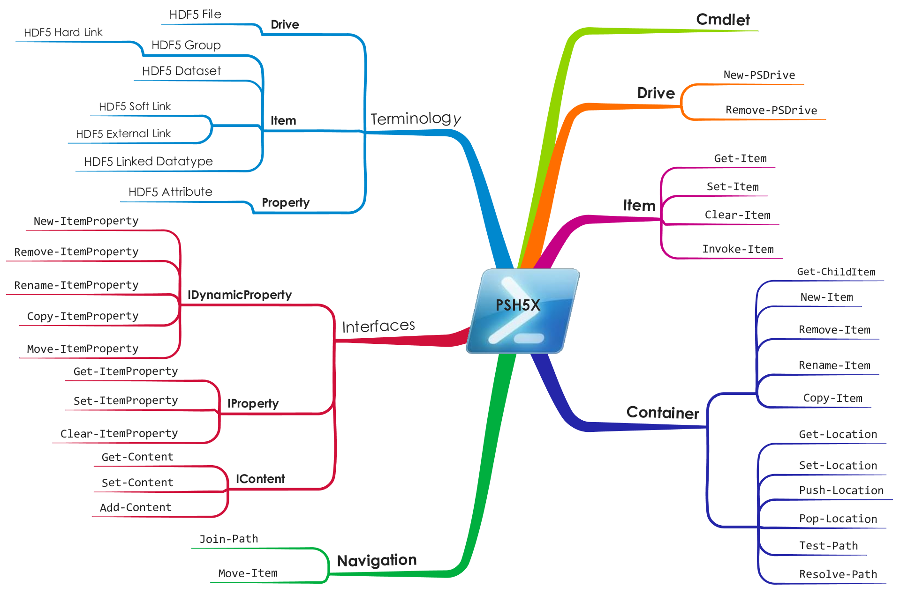
Provider Core

Slide 33
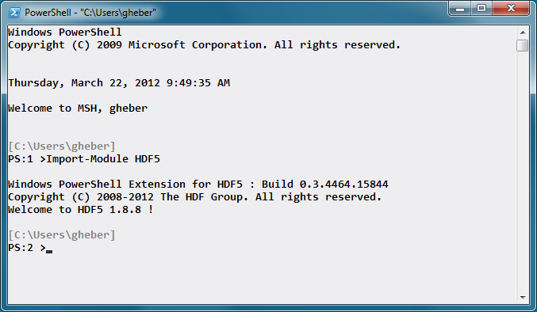
Show Time

Slide 34
Windows PowerShell Resources
Bruce Payette, Windows PowerShell in Action, 2nd Edition, Manning 2011
Scripting with Windows PowerShell
Windows PowerShell: Learn It Before It’s an Emergency – Part 1-5
Windows PowerShell Blog

Slide 35
Questions?

Slide 36
HDF5 AND DATABASES
“Complaint for true loue vnrequited.”
(Sir Thomas Wyatt, 1542)

Slide 37
Fatal Attraction
The power and simplicity of the relational model
SQL is a declarative language
  Optimizable
  Data independence
Greater productivity, because it’s easier to express intent at a high-level
(Source: Don Chamberlin on SQL in “Masterminds of Programming”, O’Reilly 2009)

Slide 38
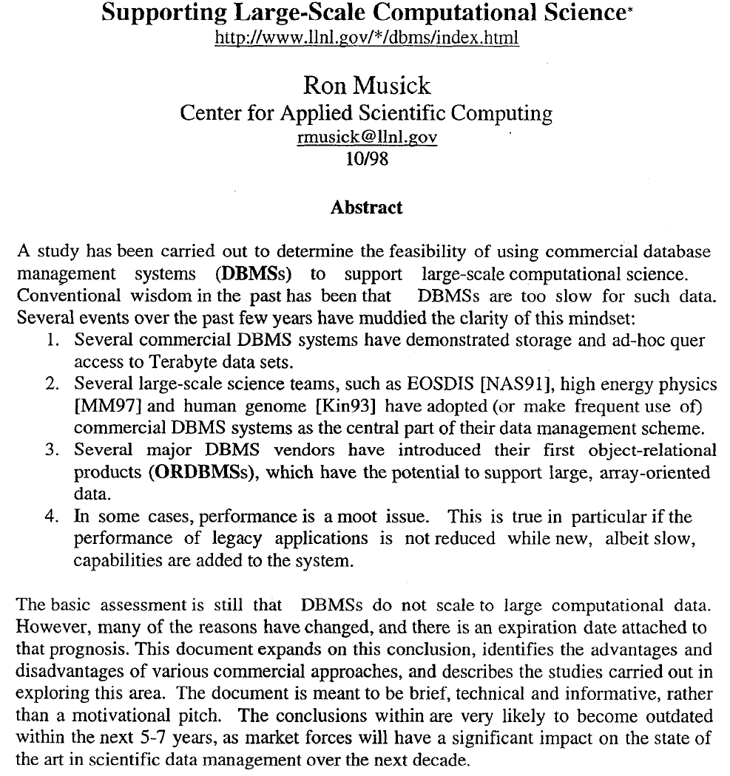
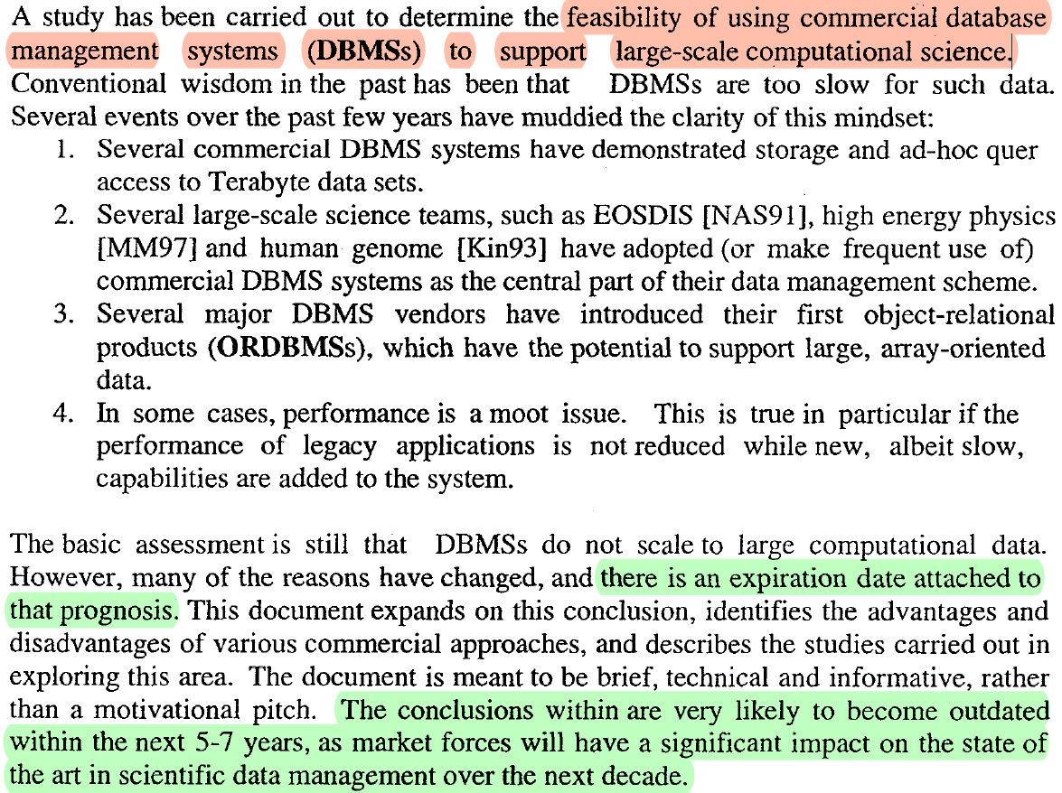
First Symptoms (Mid-Late 90s)

Slide 39
HDF and HDF-EOS Workshop 1
An HDF-EOS DataBlade
using Informix’s Object- Relational Database
Renu Chaudhry ECOlogic www.ecologic.net
September 8-10, 1897
GSFC, Maryland
Notes:
What happened?

Slide 40
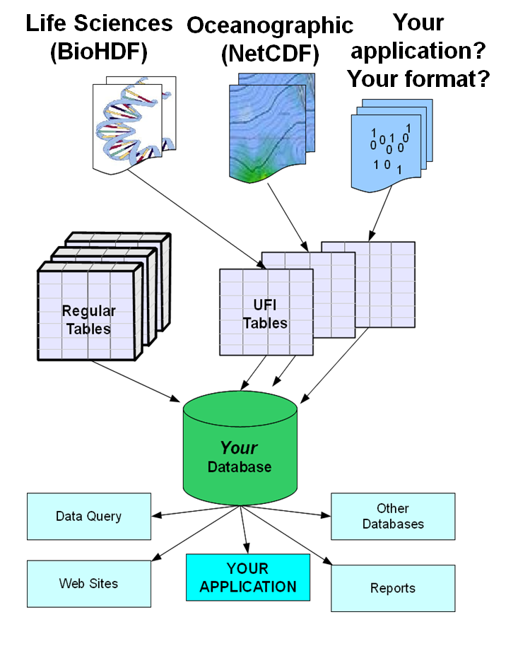
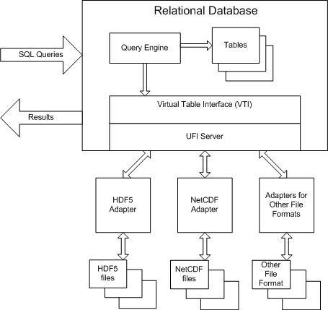
BCS Universal File Interface
Source: Barrodale Computing Services Ltd.
http://www.barrodale.com/universal-file-interface-ufi

Slide 41


Slide 42
SciQL Highlights
An extension of SQL:2003 (pronounced as ‘cycle’)
Array as first class citizens of DBMS
Seamless integration of tables and arrays
Named dimensions with constraints
Flexible structure-based grouping

Slide 43
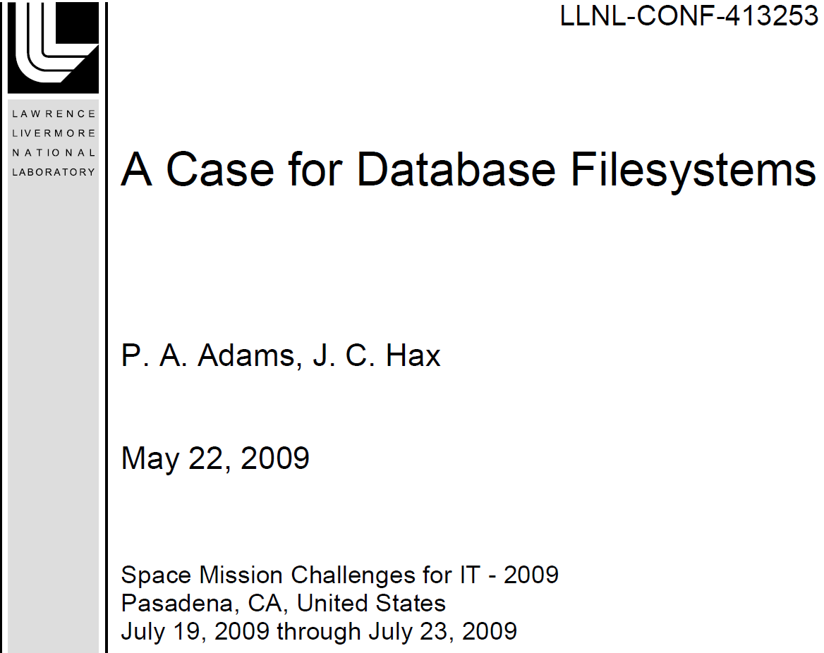

Slide 44
HDF5/DBMS Summary
Three significant developments:
  Arrays can be first class citizens
  Database file systems offer the potential to store Level 0 data and analyze Level 1 and Level 3 data within the same DBMS
  All vendors (IBM, Microsoft, Oracle) have rolled out BigData connectors
Databases have morphed into data hubs.
We are working hard to get HDF5 connected!

Slide 45
Thank You!

Slide 46
Acknowledgements
This work was supported by Subcontract number 114820 under Raytheon Contract number NNG10HP02C, funded by the National Aeronautics and Space Administration (NASA) and by cooperative agreement number NNX08AO77A from the NASA. Any opinions, findings, conclusions, or
recommendations expressed in this material are those of the authors and do not necessarily reflect the views of Raytheon or the National Aeronautics and Space Administration.

Slide 47
Questions/comments?

